Slide 1
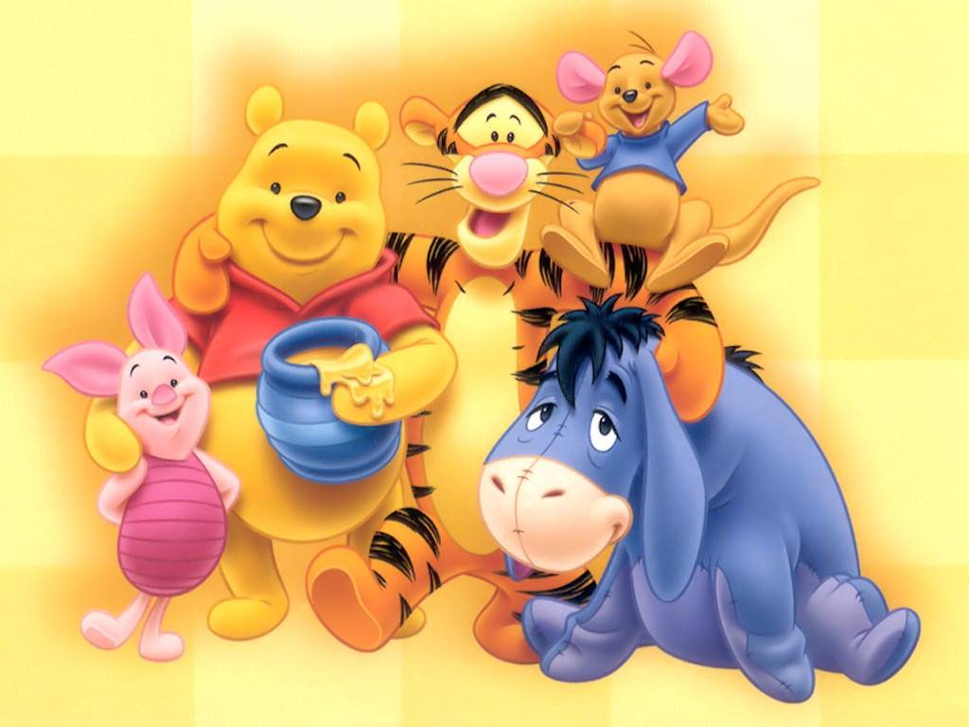
Winnie-the-Pooh

Slide 2
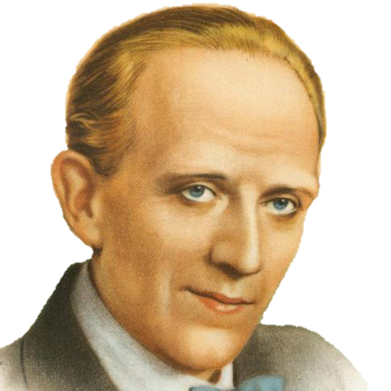
Who is the author of the book?
Oscar Wilde
Lewis Carrol
Alan Alexander Milne
John Tolkien

Slide 3
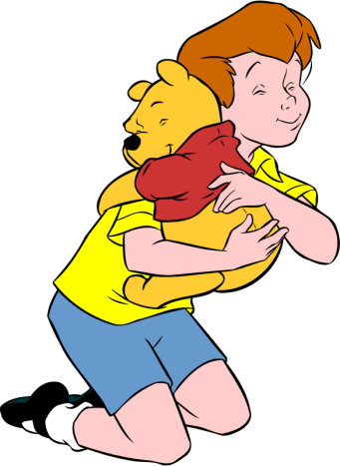
What was the name of
the boy who had Winnie-the-Pooh?
- Tom Sawyer
- Kelly Ward
- Harry Potter
- Christopher Robin

Slide 4
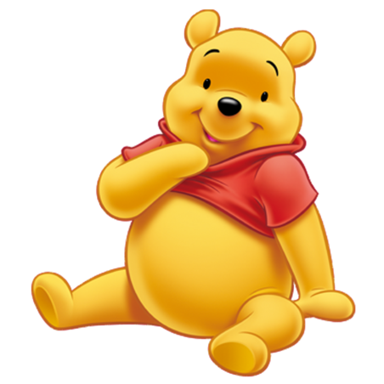
Who is Winnie-the-Pooh?
- bear
- wolf
- pig
- rabbit

Slide 5
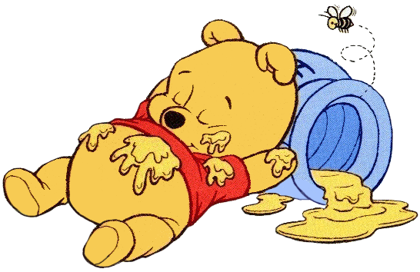
What’s Winnie-the-Pooh’s
favourite dish?
- ice-cream
- chocolate
- honey
- sweets

Slide 6
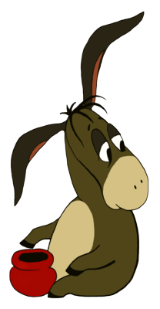
What did Winnie-the-Pooh give
Eeyore as a present?
- flowers
- a pot without honey
- tail
- cake

Slide 7
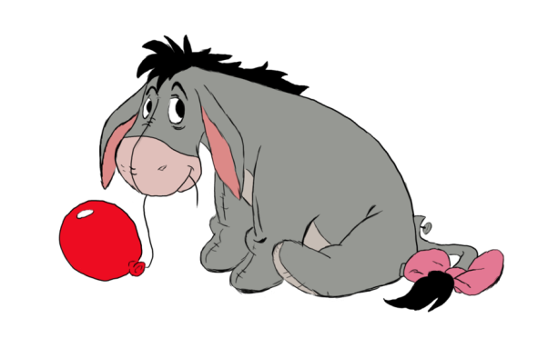
What’s Eeyore’s favourite colour?
- blue
- green
- red
- brown

Slide 8
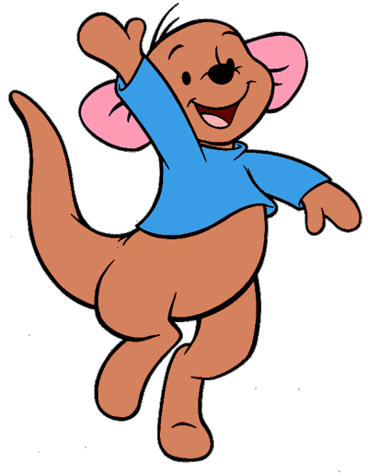
What’s the name of Kanga’s son?
- Roo
- Piglet
- Eeyore
- Robin

Slide 9

What did Eeyore lose?
- balloon
- a pot with honey
- tail
- money

Slide 10
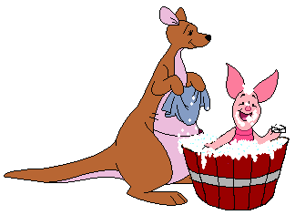
What happened to Piglet
when he was at Kanga’s house?
- washed the dishes
- played games
- washed his face and hands
- had a bath

